Slide 1


Department of CSE(DS) A mini project on using Random Forest Airline Flight Delay Analysis
Approved by AICTE, Affiliated to JNTUH​ Accredited by NAAC-A Grade, NBA& ISO 9001:2015 Certified​
TEAM MEMBERS
ROLL NO
N.SHIVAMANI​
M.LIKITH​
D.BHAGAVAN​
K.SHIVAKUMAR
22VE1A67A2​
22VE1A6794
​
22VE1A6772
​
23VE5A6709​
Under the guidance of
Mr. D . Srikar (Asst Professor)
Academic batch:-2022-2026

Slide 2
Abstract
Flight delays pose significant challenges to airline operations, impacting both cost efficiency and customer satisfaction. This project aims to develop a data-driven solution by building Random Forest classification and regression models to predict and analyze flight delays. Using historical flight data from the U.S. Department of Transportation (DOT) for the year 2015, the system performs comprehensive data preprocessing and exploratory analysis using Python libraries such as Pandas, NumPy, and Matplotlib. The classification model predicts whether a flight will be delayed by more than 15 minutes, while the regression model estimates the exact delay duration. Both models are implemented in Python using Jupyter Notebooks and demonstrate strong predictive performance, with the Random Forest classifier achieving an accuracy of up to 87%. This dual-model approach provides airlines with actionable insights for proactive planning, resource optimization, and improved customer service.
Keywords:-Flight delays, Random Forest, classification model, regression model, prediction, historical flight data , data preprocessing, exploratory data analysis, Python, Jupyter Notebooks, Pandas, NumPy, Matplotlib, delay duration, model accuracy, proactive planning, resource optimization, customer satisfaction

Slide 3
TABLE OF CONTENT
Abstract
Literature survey
Existing System
Disadvantage of Existing System
Proposed System
Advantages
Architecture
Flow Chart
UML(packages)
Data Set
System Requirements
Code
Outputs
visualizations
References

Slide 4
Literature survey
Ahmed et al. (2018) applied logistic regression to flight delay prediction but faced limited accuracy
and difficulty capturing complex patterns.
Zhang & Zhang (2019) used Random Forest models, showing improved accuracy but noted
computational complexity and tuning challenges.
Kuo et al. (2022) emphasized the importance of including dynamic factors like airport congestion
and route-specific variations in delay models.
Liu et al. (2024) integrated weather data for better predictions but highlighted issues with data
timeliness and lack of user-friendly prediction tools.

Slide 5
EXISTING SYSTEM
Flight delays are currently managed reactively rather than predictively.
Airlines and airports collect large volumes of flight data, but most of it is used for reporting purposes.
Delay information is updated in real-time and shared with passengers via apps and airport screens.
Existing predictive models, such as logistic regression and other classification algorithms, achieve accuracy between 72% and 80%.
Most causes of flight delays—such as weather, air traffic, or technical issues—are identified shortly before departure.
This late identification limits the ability to notify passengers early or adjust flight schedules proactively.
Current systems lack in-depth analysis of historical delay patterns across different time periods, routes, or carriers.

Slide 6
Disadvantages of existing system :-
Moderate Model Performance: Accuracy of 68% and low recall for delays.
Class Imbalance Issues: Despite balancing, minority class (delays) prediction is weak.
Data Loss in Preprocessing: Removing 1.8 million rows due to missing weather data.
Weather Data Approximation: Using nearest weather stations may not capture exact airport conditions.
Feature Limitations: Missing key variables like mechanical issues, air traffic congestion.
Lack of Real-Time Data: Reliance on historical averages instead of real-time inputs.
Computational Constraints: Limited hyperparameter tuning and model experimentation

Slide 7
Proposed System :
Improve flight delay management by integrating statistical analysis, machine learning, and web deployment.
Process historical flight data using Python libraries such as SciPy and Pandas to extract key features (month, day, hour, airline, airport).
Use a Random Forest classifier to predict if a flight will be delayed by more than 15 minutes, benefiting from its accuracy and ability to handle complex data.
Develop a Flask-based web interface for users to upload data, view delay tends, and receive real-time delay predictions.
Enable a proactive, data-driven approach to efficiently manage flight delays.

Slide 8
Advantages:
Structured Preprocessing Pipelines : Using Column Transformer and Pipeline for organized and leak-proof data processing.
Handling High-Cardinality Features : Alternative encoding methods like Target Encoder.
Faster Iteration with Subsampling : Ability to test models on smaller datasets quickly.
Parallel Processing : Utilization of multiple cores for faster model training.
Dual Modeling Approach : Both classification and regression tasks addressed.
Feature Engineering : Techniques like grouping rare categories to improve model robustness.
Reproducibility and Maintainability : Code structure that supports easier updates and reproducibility.

Slide 9
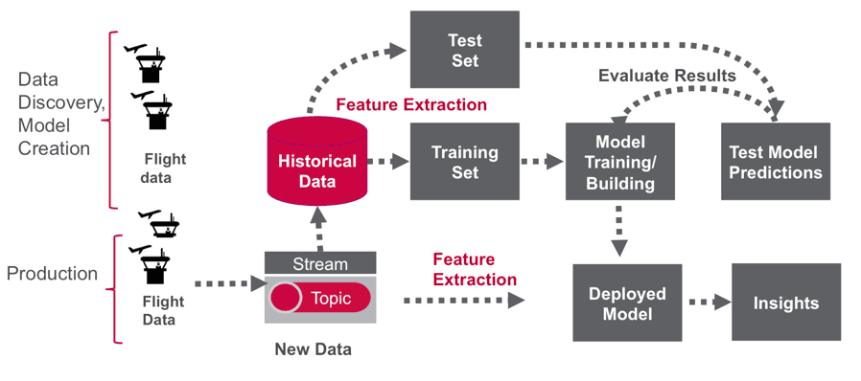
ARCHITECTURE
Data processing pipeline for predicting flight delays

Slide 10
Flow Chart :
Data Ingestion
Preprocessing
Feature Engineering
Evaluation
Prediction
Model Training

Slide 11
Data Set Records
SNO | SCHEDULED_ DEPARTURE | SCHEDULED_ARRIVAL | DEPARTURE_TIME | ARRIVAL_ TIME | DEPARTURE_ DELAY | ARRIVAL_ DELAY
0 | 2015-01-01 00:05:00 | 04:30:00 | 23:54:00 | 04:08:00 | -11.0 | -22.0
1 | 2015-01-01 00:10:00 | 07:50:00 | 00:02:00 | 07:41:00 | -8.0 | -9.0
2 | 2015-01-01 00:20:00 | 08:06:00 | 00:18:00 | 08:11:00 | -2.0 | 5.0
3 | 2015-01-01 00:20:00 | 08:05:00 | 00:15:00 | 07:56:00 | -5.0 | -9.0
4 | 2015-01-01 00:25:00 | 03:20:00 | 00:24:00 | 02:59:00 | -1.0 | -21.0
5 | 2015-01-01 00:25:00 | 06:02:00 | 00:20:00 | 06:10:00 | -5.0 | 8.0

Slide 12
UML (Packages):
Preprocessor
+ load_data() + clean_data() + encode_features()
ModelTrainer
+ train_model() + save_model()
Predictor
+ load_model() + predict()
Utils
+ log() + get_config()

Slide 13
SYSTEM REQUIREMENTS(USED)
OS:-Windows 11
RAM=minimum 8gb
Storage= minimum 50GB

Slide 14
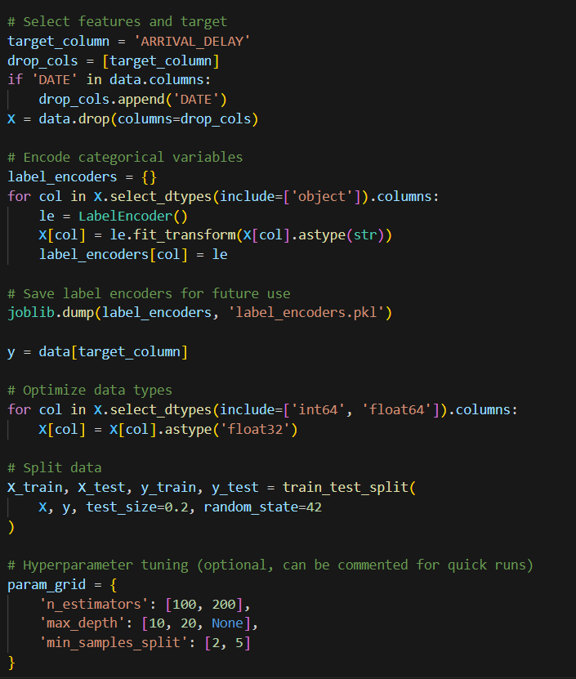
CODE

Slide 15
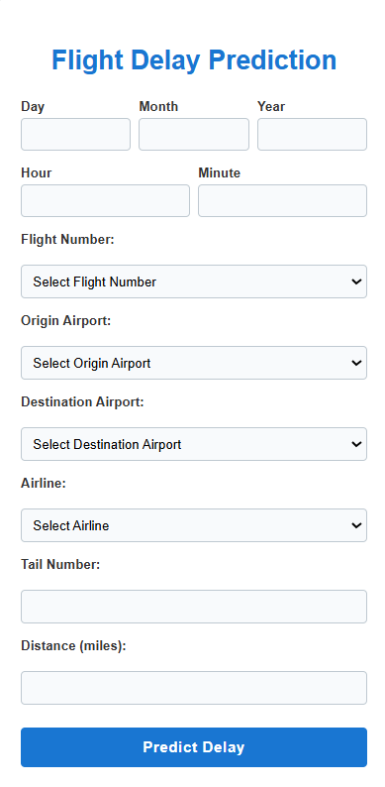
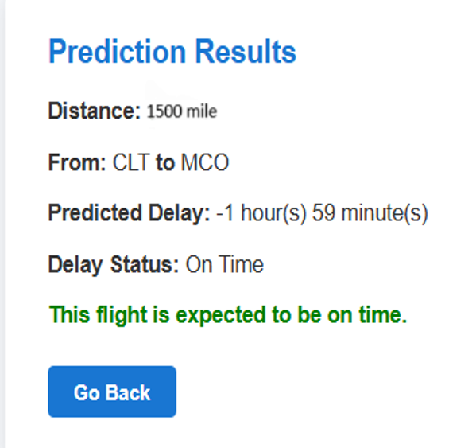
OUTPUT

Slide 16
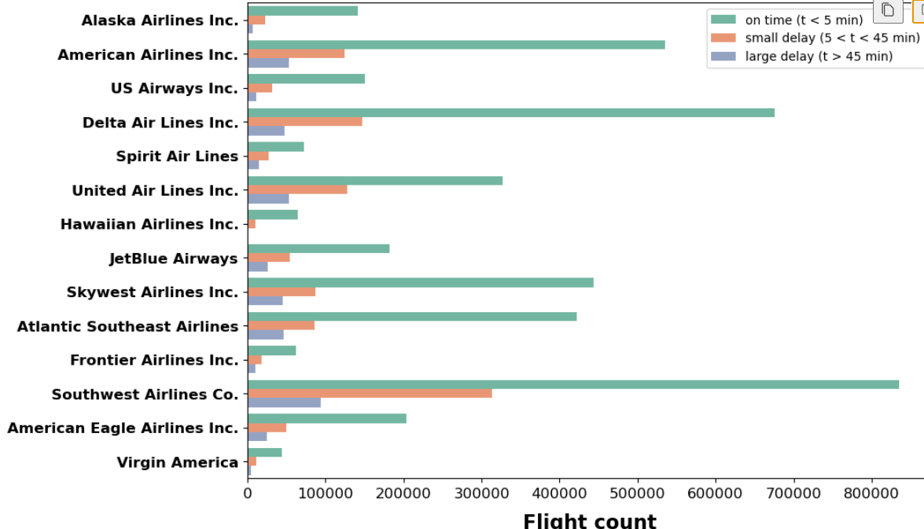
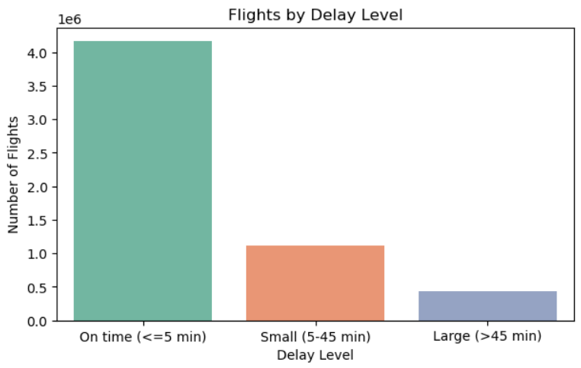
Visualizations

Slide 17
CONCLUSION
Flight Delay Prediction with Random Forest Summary of Findings Our flight delay prediction project using Random Forest achieved
strong results:-
87.3% accuracy in classifying flights as delayed or on-time-
84% precision for delayed flights (minimizing false alarms)-
77% recall for delayed flights (identifying most actual delays)-
Clear feature importance insigh showing which factors most

Slide 18
References :
[1] https://link.springer.com/article/10.1186/s40537-023-00867-5
[2]https://www.macawpublications.com/Journals/index.php/MIJARCSE/article/view/68
[3] https://doi.org/10.1109/ic2pct60090.2024.10486482
[4]https://www.emerald.com/insight/content/doi/10.1108/02656719510080613/full/html

Slide 19


